Slide 1
Theory of Automata Kleene’s Theorem
Week 4

Slide 2
Contents
Unification
Turning TGs into Regular Expressions
Converting Regular Expressions into FAs
Nondeterministic Finite Automata
NFAs and Kleene’s Theorem

Slide 3
Unification
We have learned three separate ways to define a language: (i) by regular expression, (ii) by finite automaton, and (iii) by transition graph.
Now, we will present a theorem proved by Kleene in 1956, which says that if a language can be defined by any one of these three ways, then it can also be defined by the other two.
In other words, Kleene proved that all three of these methods of defining languages are equivalent.

Slide 4
Theorem 6 - Kleene’s Theorem
Any language that can be defined by regular expression, or finite automaton, or transition graph can be defined by all three methods.

Slide 5
Kleene’s Theorem
This theorem is the most important and fundamental result in the theory of finite automata.
We will take extreme care with its proofs. In particular, we will introduce four algorithms that enable us to construct the corresponding machines and expressions.
Recall that
– To prove A = B, we need to prove (i) A ⊂ B, and (ii) B ⊂ A.
– To prove A = B = C, we need to prove (i) A ⊂ B, (ii) B ⊂ C, and (iii) C ⊂ A.

Slide 6
Kleene’s Theorem
Thus, to prove Kleene’s theorem, we need to prove 3 parts:
Part 1: Every language that can be defined by a finite automaton can also be defined by a transition graph.
Part 2: Every language that can be defined by a transition graph can also be defined by a regular expression.
Part 3: Every language that can be defined by a regular expression can also be defined by a finite automaton.

Slide 7
Proof of Part 1
This is the easiest part.
From previous lecture, we know that every finite automaton is itself already a transition graph. Therefore, any language that has been defined by a finite automaton has already been defined by a transition graph.

Slide 8
Turning TGs into Regular Expressions
Notes:
8

Slide 9
Proof of Part 2: Turning TGs into Regular Expressions
We prove this part by providing a constructive algorithm:
– We present a algorithm that starts out with a transition graph and ends up with a regular expression that defines the same language.
– To be acceptable as a method of proof, the algorithm we present will satisfy two criteria:
It works for every conceivable TG, and
It guarantees to finish its job in a finite number of steps.
Slides 8 - 27 below present the proof of part 2.

Slide 10
Step-1 Creating A Unique Start State
Consider an abstract transition graph T that may have many start states.
We can simplify T so that it has only one unique start state that has no incoming edges.
We do this by introducing a new start state that we label with the minus sign, and that we connect to all the previous start states by edges labeled with Λ. We then drop the minus signs from the previous start states.
If a word w used to be accepted by starting at one of the previous start states, then it can now be accepted by starting at the new unique start state.
The following figure illustrates this idea.

Slide 11
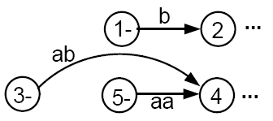
Consider a fragment of T:
The above fragment of T can be replaced by

Slide 12
Step 2 - Creating a Unique Final State
Let us make another simplification in T so that it has a unique, un-exitable final state, without changing the language it accepts.
If T had no final state, then it accepts no strings at all and has no language. So, we need to produce no regular expression other than the null, or empty, expression Φ(see page 36 of the text).
If T has several final states, we can introduce a new unique final state labeled with a plus sign. We then draw new edges from all the former final states to the new one, dropping the old plus signs, and labeling each new edge with the null string.
This process is depicted in the next slide.

Slide 13
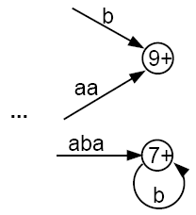
becomes

Slide 14
We shall require that the unique final state be a different state from the unique start state. If an old state used to have ±, then both signs are removed from the old state to newly created states, using the processes described above.
It should be clear that the addition of these two new states does not affect the language that T accepts.
The machine now has the following shape:
where there are no other - or + states.

Slide 15


Step 3 -- Combining Edges
If T has some internal state x (not the - or the + state) that has more than one loop circling back to itself:
where r₁, r₂, and r₃ are all regular expressions or simple strings.
We can replace the three loops by one loop labeled with a regular expression:

Slide 16

Combining Edges
Similarly, if two states are connected by more than one edge going in the same direction:
We can replace this with a single edge labeled with a regular expression:

Slide 17

Bypass and State Elimination
If T has 3 states in a row connected by edges labeled with regular expressions or simple strings, we can eliminate the middle state, as in the following examples:
Can be replaced with

Slide 18

Bypass and State Elimination
If the middle state has a loop, we can proceed as follows:
Can be replaced with

Slide 19
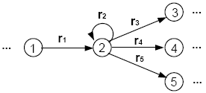
Bypass and State Elimination
If the middle state is connected to more than one state, then the bypass and elimination process can be done as follows:
Can be replaced with

Slide 20
Special Cases
Can be replaced with

Slide 21
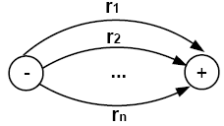
Combining Edges
We can repeat this bypass and elimination process again and again until we have eliminated all the states from T, except for the unique start state and the unique final state. What we come down to is a picture that looks like this:
with each edge labeled by a regular expression.

Slide 22
Combing Edges
We can then combine the edges from the above picture one more to produce
in which the resultant expression is the regular expression that defines the same language as T did originally.
Recall that all words accepted by T are paths through the picture of T. If we change the picture but preserve all paths and their labels, we must keep the language unchanged.

Slide 23
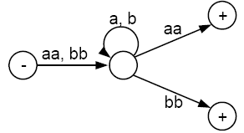
Example
Consider the following TG that accepts all words that begin and end with double letters (having at least length 4):

Slide 24
This TG has only one start state with no incoming edges, but has two final states. So, we must introduce a new unique final state:

Slide 25
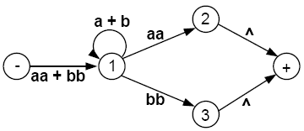
Now we build regular expressions piece by piece:

Slide 26
Eliminate state 2:

Slide 27
Eliminate state 1:

Slide 28
Eliminate state 3:

Slide 29
Hence, this TG defines the same language as the regular expression
(aa + bb)(a + b)*(aa) + (aa + bb)(a + b)*(bb)
or equivalently
(aa + bb)(a + b)*(aa + bb)
If we eliminated the states in a different order, we could end up with a different-looking regular expression. But by the logic of the elimination process, these expressions would all have to represent the same language.
We are now ready to present the constructive algorithm that proves that all TGs can be turned into regular expressions that define the exact same language.

Slide 30
Algorithm
Step 1: Create a unique, unenterable minus state and a unique, unleaveable plus state.
Step 2: One by one, in any order, bypass and eliminate all the non-minus or non-plus states in the TG. A state is bypassed by connecting each incoming edge with each outgoing edge. The label of each resultant edge is the concatenation of the label on the incoming edge with the label on the loop edge (if there is one) and the label on the outgoing edge.
Step 3: When two states are joined by more than one edge going in the same direction, unify them by adding their labels.
Step 4: Finally, when all that is left is one edge from - to +, the label on that edge is a regular expression that generates the same language as was recognized by the original TG.

Slide 31
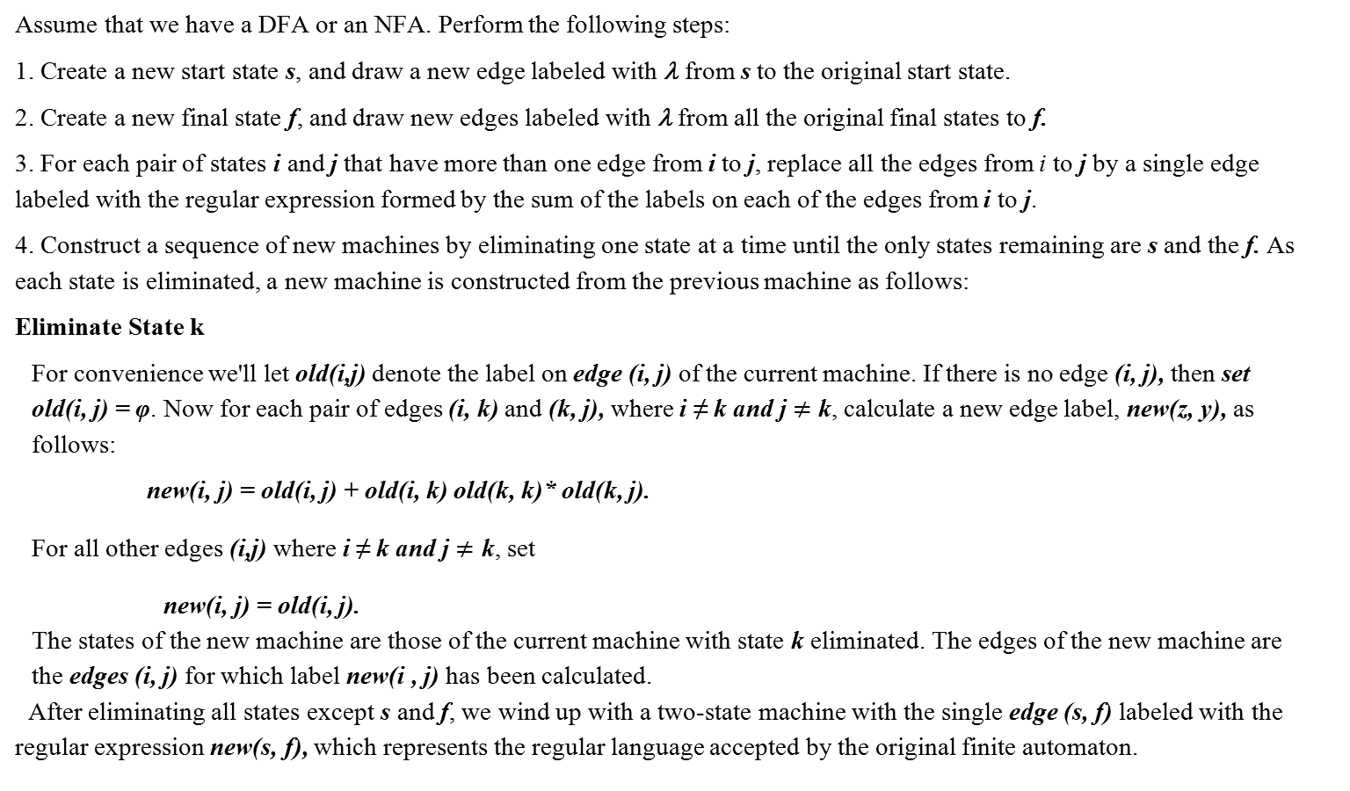
Algorithm for Finite Automaton to Regular Expression Conversion 1a

Slide 32
Converting Regular Expressions into FAs
Notes:
32

Slide 33
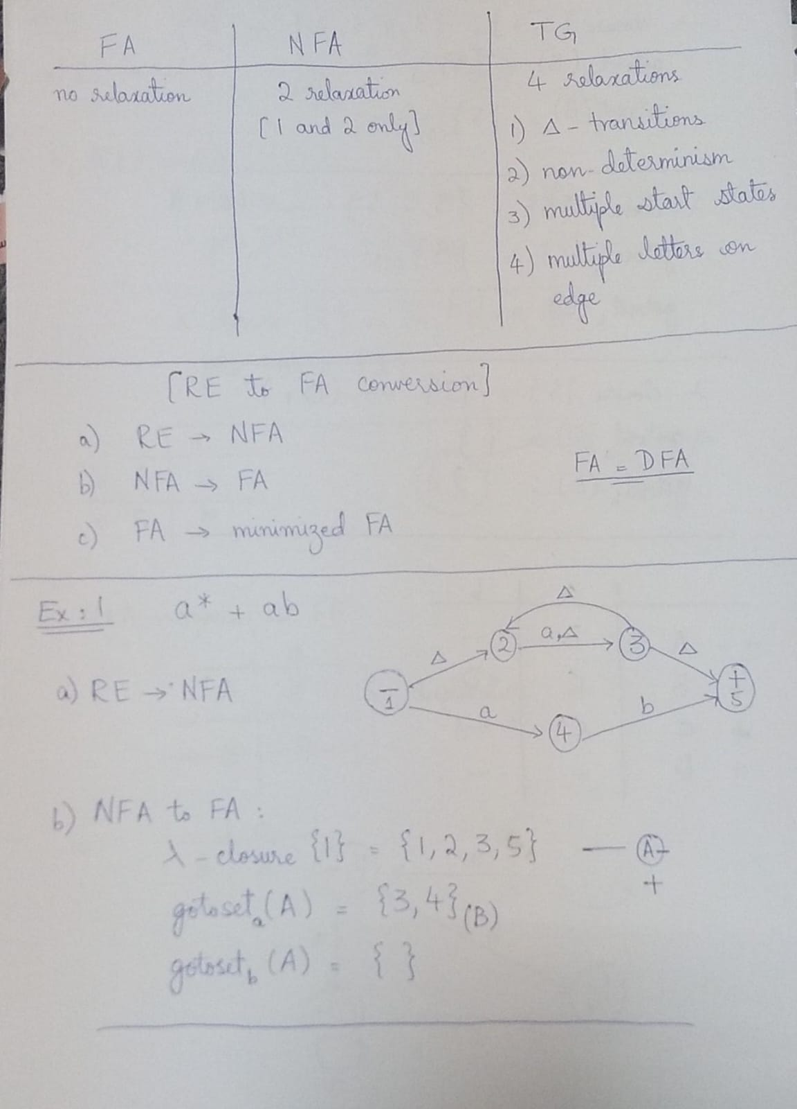

Slide 34
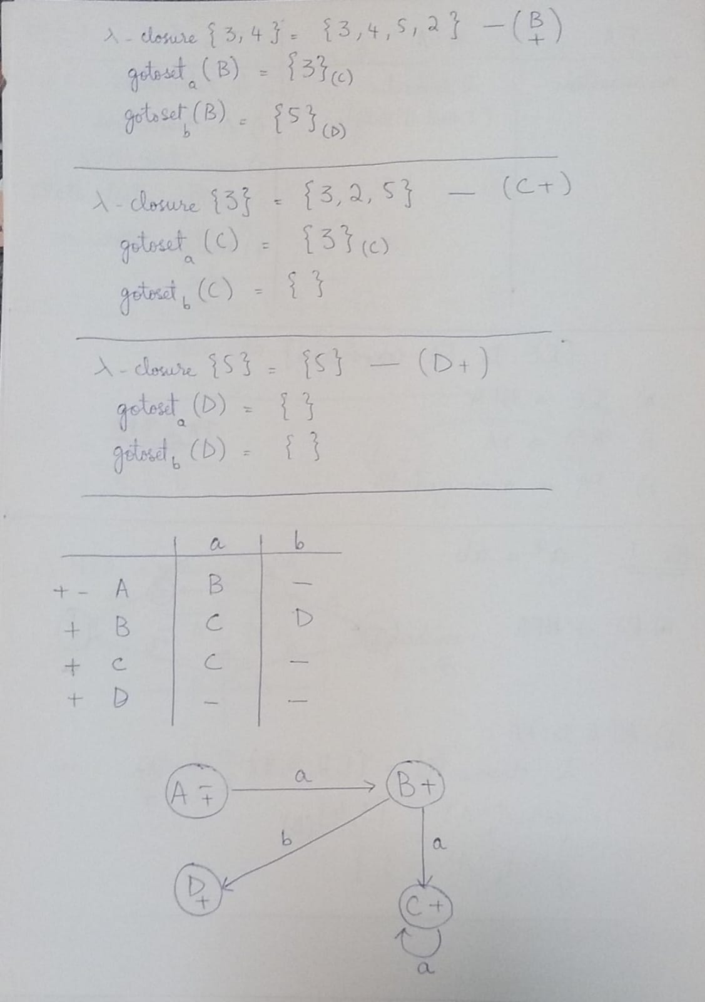

Slide 35
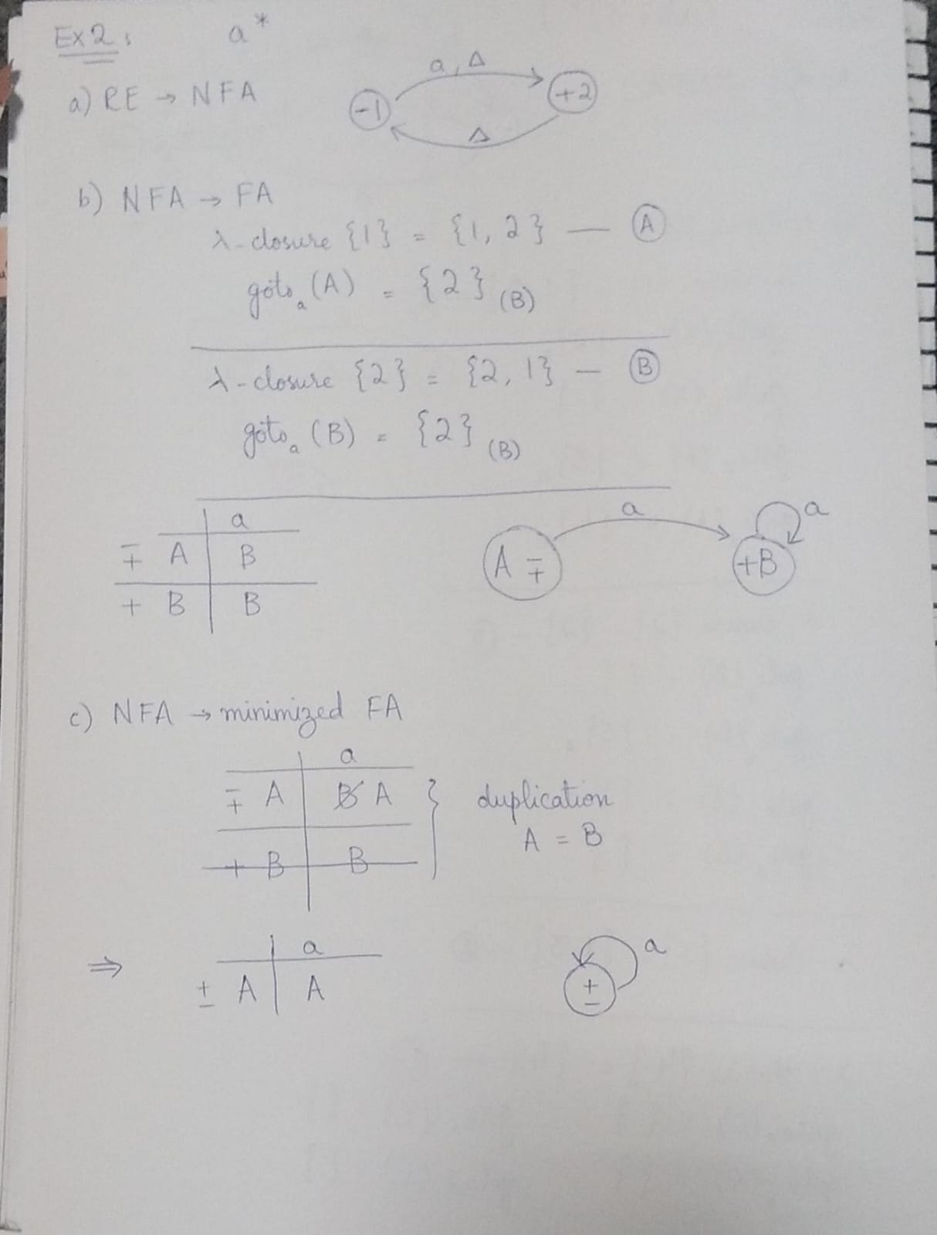

Slide 36
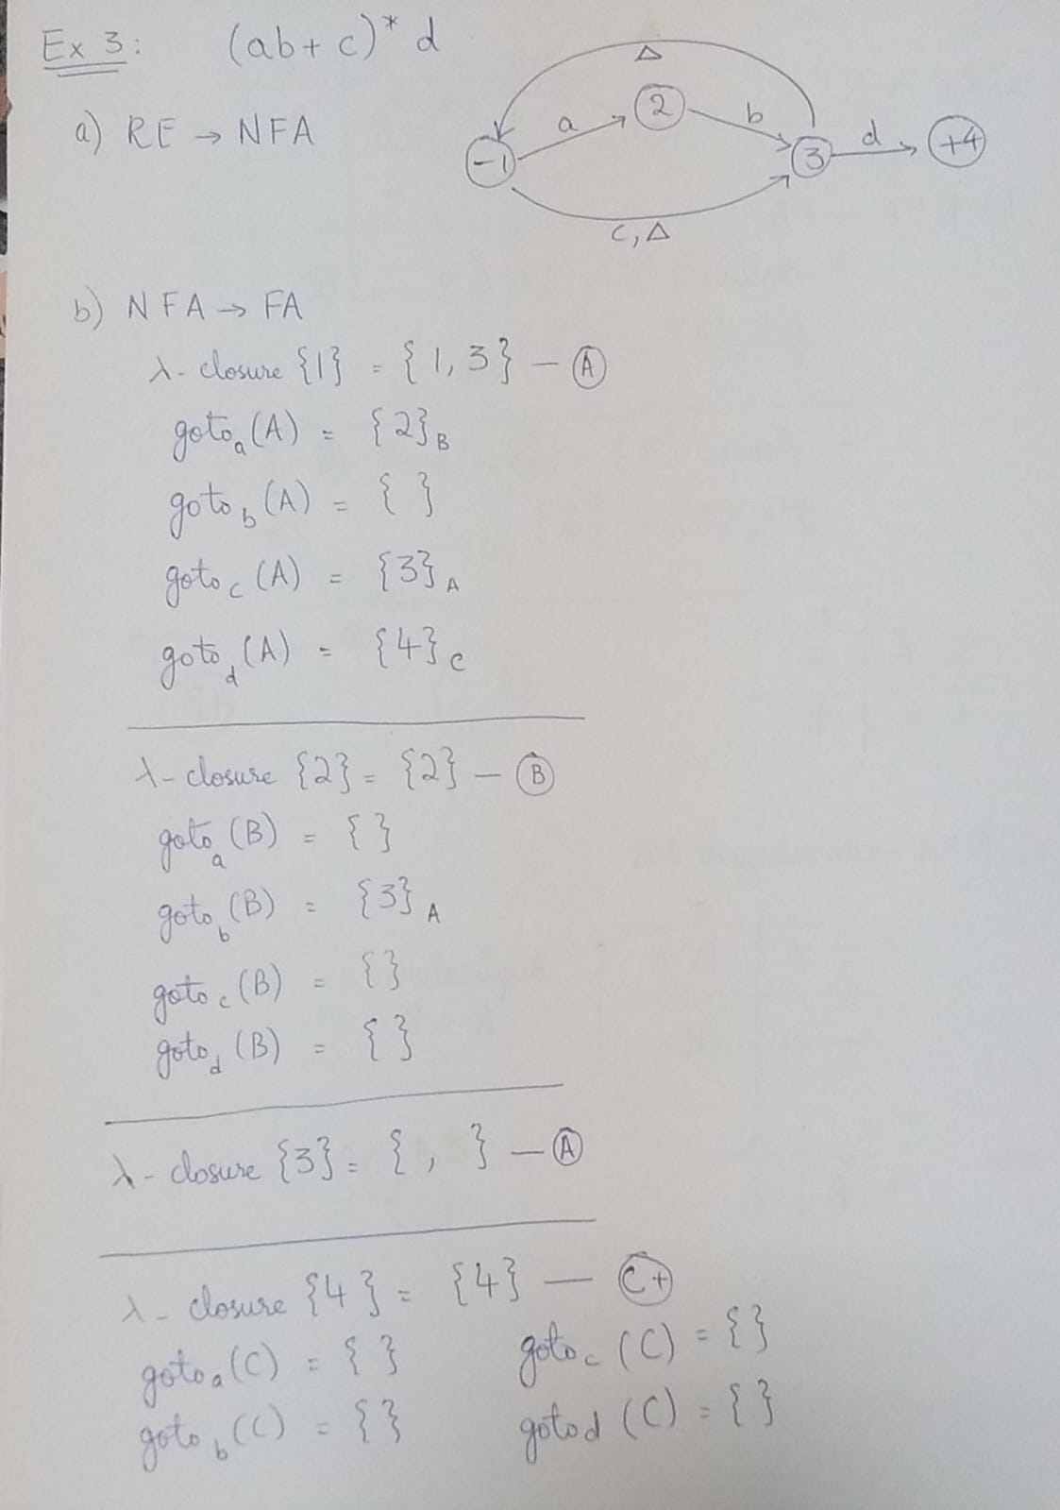

Slide 37
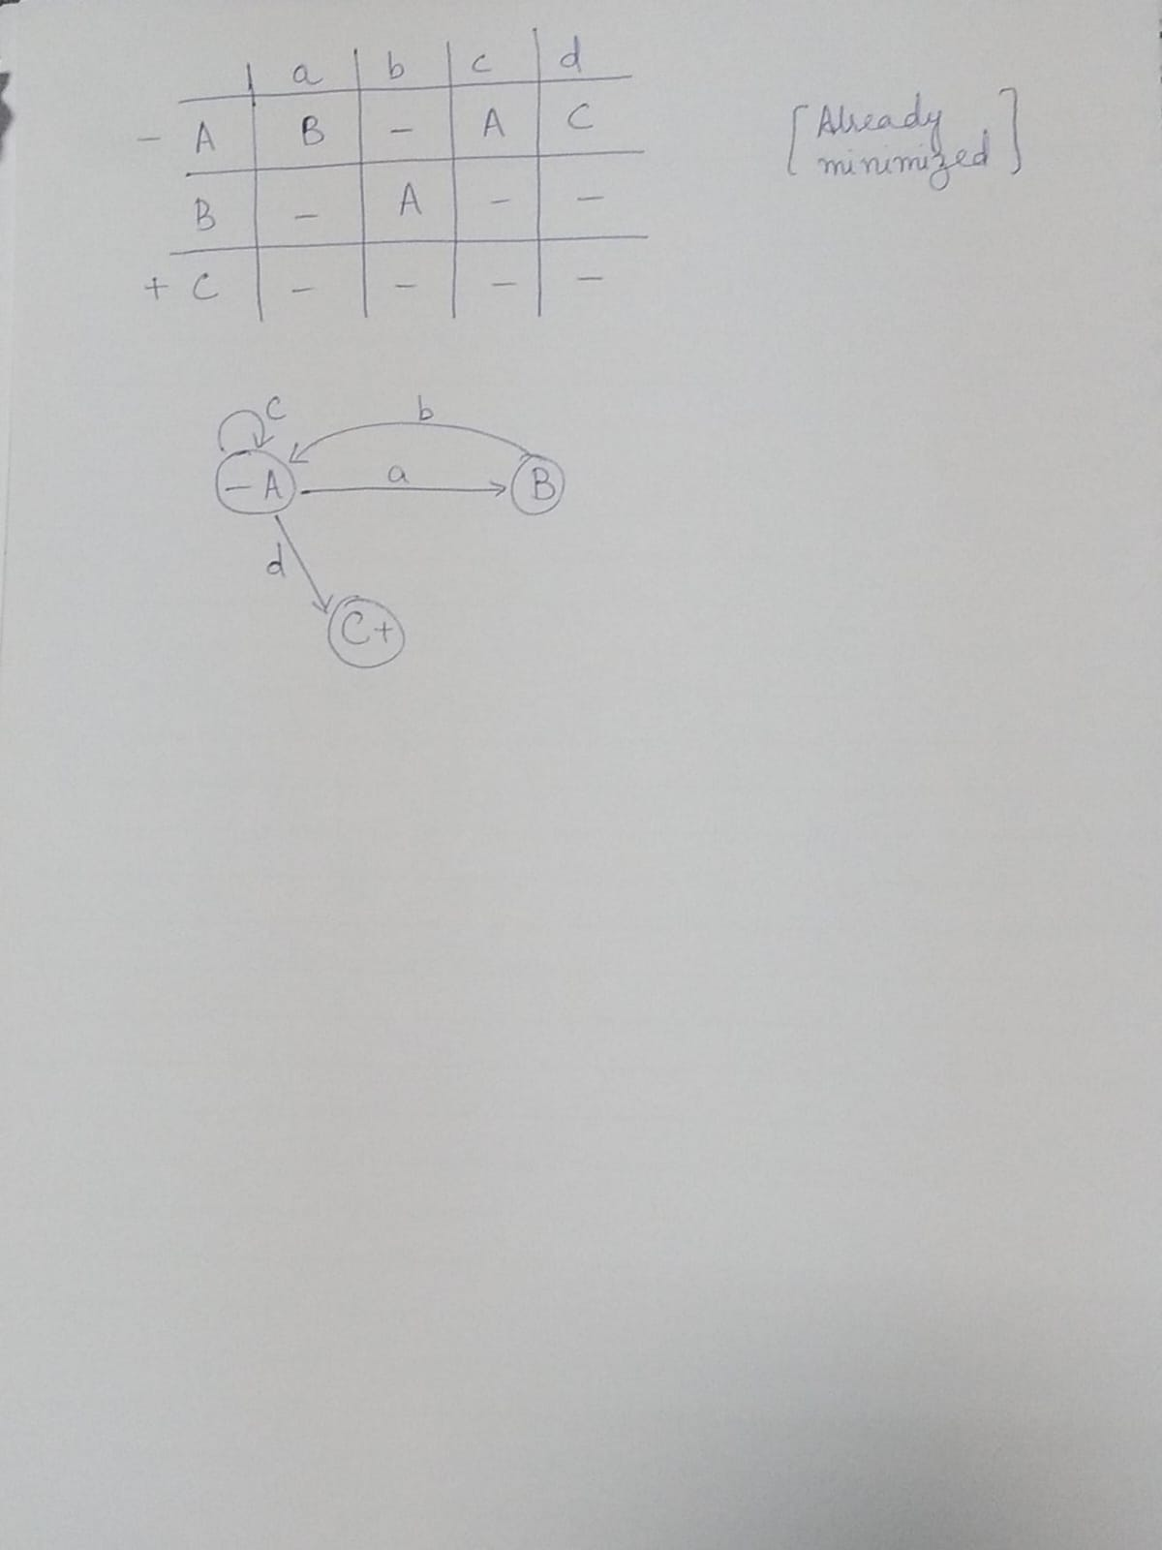

Slide 38
NFA - Non-Deterministic Finite Automata

Slide 39
NFA
Definition: An NFA is a TG with a unique start state and with the property that each of its edge labels is a single alphabet letter.
The regular deterministic finite automata are referred to as DFAs, to distinguish them from NFAs.
As a TG, an NFA can have arbitrarily many a-edges and arbitrarily many b-edges coming out of each state.
An input string is accepted by an NFA if there exists any possible path from - to +.

Slide 40
NFA
An NFA is quintuple M={Q,Σ,q₀, F, δ}
Q is set of finite states
Σ is a finite set of symbols called alphabet
q₀ belongs to Q is distinguished Start State
F is subset of Q called the Final or Accepting states
δ is a total function from Q x Σ to P(Q) known as transition function, such that, an input symbol may cause more than one next states, i.e., to one state out of a set of possible next states.
P(Q) is the power set of Q, that is, 2^{Q}

Slide 41
NFA
Definition: A nondeterministic finite automaton (or NFA) is a TG with a unique start state and with the property that each of its edge labels is a single alphabet letter.
The regular deterministic finite automata are referred to as DFAs, to distinguish them from NFAs.
As a TG, an NFA can have arbitrarily many a-edges and arbitrarily many b-edges coming out of each state.
An input string is accepted by an NFA if there exists any possible path from - to +.
Notes:
41

Slide 42
Nondeterministic Finite Accepter (NFA)
Alphabet =
Notes:
42

Slide 43
Nondeterministic Finite Accepter (NFA)
Alphabet =
Two choices
Notes:
43

Slide 44
Nondeterministic Finite Accepter (NFA)
Alphabet =
Two choices
No transition
No transition
Notes:
44

Slide 45
First Choice
Notes:
45

Slide 46
First Choice
Notes:
46

Slide 47
First Choice
Notes:
47

Slide 48
First Choice
“accept”
Notes:
48

Slide 49
Second Choice
Notes:
49

Slide 50
Second Choice
Notes:
50

Slide 51
Second Choice
No transition:
the automaton hangs
Notes:
51

Slide 52
Second Choice
“reject”
Notes:
52

Slide 53
Observation
An NFA accepts a string:
if
there is a computation of the NFA
that accepts the string
Notes:
53

Slide 54
Example
is accepted by the NFA:
Notes:
54

Slide 55
Lambda Transitions
Notes:
55

Slide 56
Notes:
56

Slide 57
Notes:
57

Slide 58
(read head doesn’t move)
Notes:
58

Slide 59
Notes:
59

Slide 60
“accept”
String is accepted
Notes:
60

Slide 61
Language accepted:
Notes:
61

Slide 62
Another NFA Example
Notes:
62

Slide 63
Notes:
63

Slide 64
Notes:
64

Slide 65
Notes:
65

Slide 66
“accept”
Notes:
66

Slide 67
Another String
Notes:
67

Slide 68
Notes:
68

Slide 69
Notes:
69

Slide 70
Notes:
70

Slide 71
Notes:
71

Slide 72
Notes:
72

Slide 73
Notes:
73

Slide 74
“accept”
Notes:
74

Slide 75
Language accepted
Notes:
75

Slide 76
Another NFA Example
Notes:
76

Slide 77
Language accepted
Notes:
77

Slide 78
Notes:
78

Slide 79
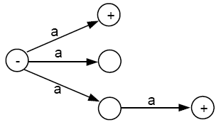
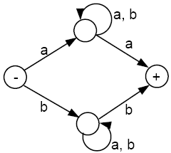
Examples of NFAs

Slide 80
Theorem 7
for every NFA, there is some FA that accepts exactly the same language.
Proof 1
By the proof of part 2 of Kleene’s theorem, we can convert an NFA into a regular expression, since an NFA is a TG.
By the proof of part 3 of Kleene’s theorem, we can construct an FA that accepts the same language as the regular expression. Hence, for every
NFA, there is a corresponding FA.

Slide 81
Distinguished Features
FA/DFA
One start state ONLY & Zero or more Final States
NFA
One start state ONLY & Zero or More Final States
Null transitions
Non-determinism
TG
One or More Start States
Zero or More Final States
Multiple letters on the edges
Null transitions
Non-determinism

Slide 82
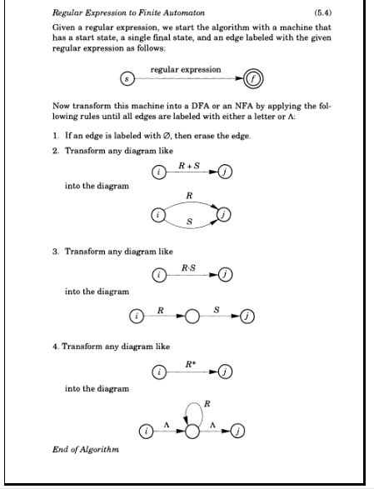

Slide 83
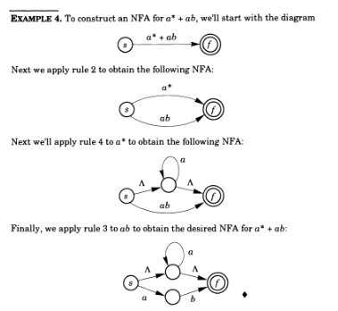

Slide 84

Show that the following DFA is equivalent to R.E
(a+b)*abb

Slide 85
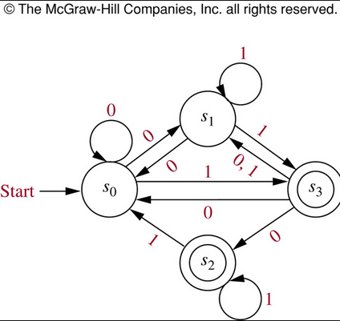
NFA to DFA Conversion

Slide 86
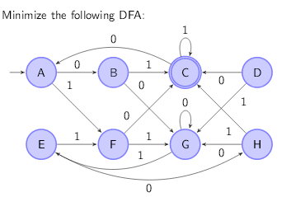
DFA Minimization

Slide 87
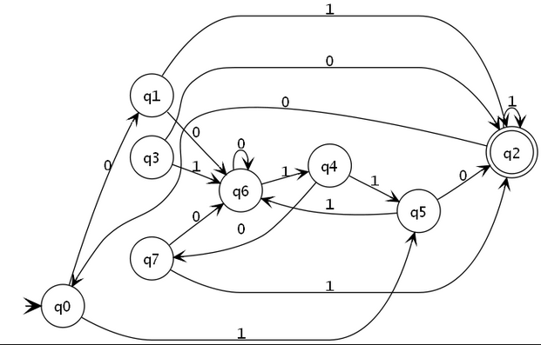
DFA Minimization

Slide 88
